Slide 1
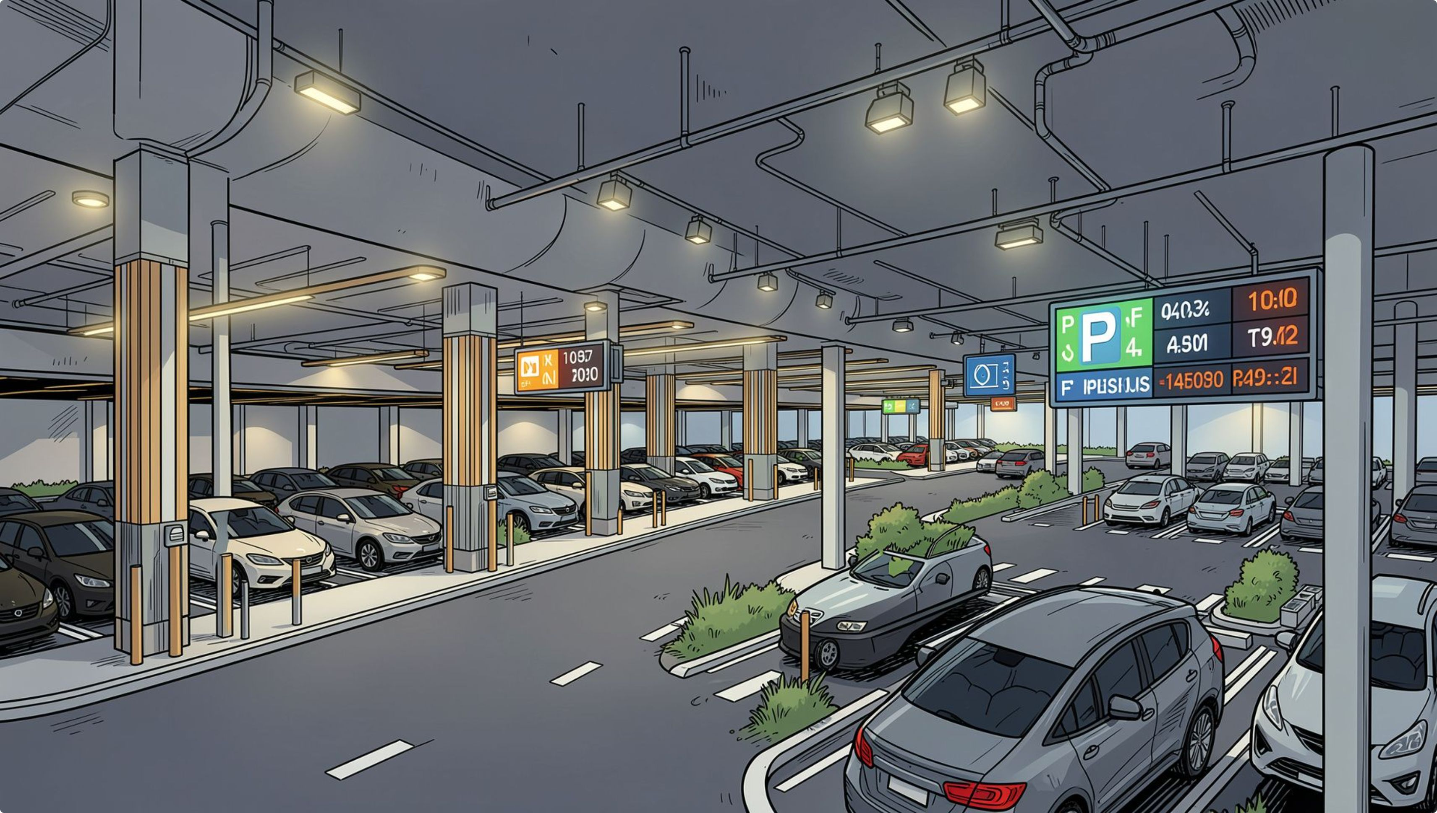

DIGITAL LOGIC DESIGN · KLH UNIVERSITY
Smart Parking System
Combinational Logic Implementation
Logic League

Slide 2

Circuit Simulation in Logisim
This slide presents the Logisim-based implementation of the smart parking circuit, showing how combinational logic gates work together to detect parking availability and control vehicle entry.
NOT Gate
Input pin A
Inverts FULL to AVAILABLE
Sensor A state
4‑Input AND Gate
Parking Entry Logic
Input pin B
Outputs FULL when all high
Sensor B state
Input pin D
Input pin C
Sensor D state
Sensor C state
The diagram above illustrates the signal flow from sensor inputs through the AND and NOT gates to the final entry gate control output.

Slide 3
Components Used
4 Input Pins
4-Input AND Gate
Represent parking slot sensors A, B, C, and D
Outputs HIGH only when all four slots are occupied
NOT Gate
Output Pins / LEDs
Inverts the FULL signal to produce AVAILABLE output
Visual indicators for FULL and AVAILABLE status
Connecting wires link all components, enabling signal flow from inputs through logic gates to outputs.

Slide 4
Logic Implementation
Boolean Expressions
Truth Table (A, B, C, D → FULL / AVAILABLE)
FULL = A · B · C · D
Output is HIGH only when all four parking slots are occupied simultaneously.
AVAILABLE = ¬(A · B · C · D)
Inverted FULL signal — HIGH when at least one slot is free.
A
B
C
D
FULL
AVAILABLE
0
0
0
0
0
1
0
1
1
0
0
1
1
1
1
0
0
1
1
1
1
1
1
0

Slide 5

Testing in Logisim
Run Simulation
Set Inputs
Verify Results
Logisim's interactive environment allows real-time toggling of input pins, making it easy to validate all 16 input combinations and confirm correct gate behavior before hardware deployment.

Slide 6
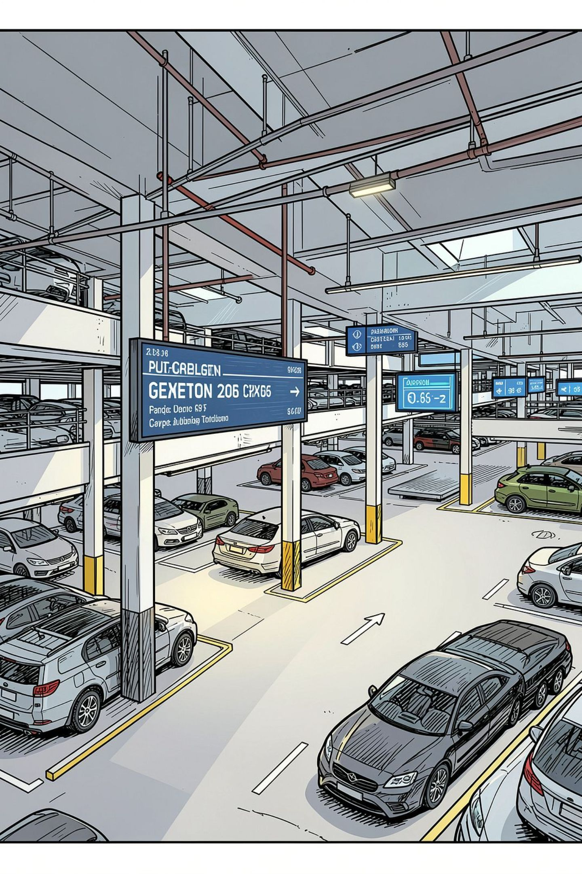
SLIDE 9
Benefits & Applications
The smart parking system delivers practical advantages for drivers and facility operators, with broad applicability across urban and institutional environments.

Slide 7
Key Advantages
Saves Time
Reduces Fuel Waste
Eases Congestion
Drivers know availability before entering, eliminating search time
Fewer circling loops means lower fuel consumption per visit
Controlled entry prevents bottlenecks at parking entrances
Low Cost
Scalable Design
Simple gate logic requires minimal hardware investment
Easily expanded to monitor additional parking slots

Slide 8
Real-World Applications
Shopping Malls
Colleges & Universities
High-traffic retail environments with multi-level parking
Student and faculty parking management across campuses
Hospitals
Railway Stations
Critical access for patients, visitors, and emergency vehicles
Long-term commuter parking with high daily turnover
Airports
Smart Cities
Multi-zone parking with real-time availability displays
IoT-integrated urban infrastructure and traffic management

Slide 9
SLIDE 10
Conclusion
This project demonstrates how combinational logic can solve a real-world parking problem — detecting slot availability, identifying when the lot is full, and controlling vehicle entry with minimal hardware.
Detects Availability
Identifies FULL State
Monitors all four parking slots in real time
AND gate triggers when all slots are occupied
Controls Entry
Foundation for IoT
NOT gate allows entry only when space is available
Scalable architecture ready for smart city integration

Slide 10
Thank You
Team: Logic League
Project Summary
Mathi Dhanvanth
Allam Akshaya
Chidura Adhitya
Kunku Abhinaya
A 4-input combinational logic circuit using an AND gate and NOT gate to manage smart parking entry — simulated and validated in Logisim.
DIGITAL LOGIC DESIGN
KLH UNIVERSITY
KLH University

